Slide 1


VIVEKANANDHA COLLEGE OF TECHNOLOGY FOR WOMEN
DEPARTMENT OF INFORMATON TECHNOLOGY
Task Scheduling and Portioning for Software Defined Network Using Reinforcement Learning
GUIDE NAME
TEAM MEMBERS
Mr.S.VIGNESH,AP/IT
Deepika.M - (613019205006)
Gokila.S - (613019205012)
Mohanapriya.P - (613019205029)

Slide 2
ABSTRACT
The Internet of Things (IOT) connect millions of devices in diverse areas such as smart cities, e-health, transportation and defense to meet a wide range of human needs. To provide these services, a large amount of data needs to be transmitted to the IOT network servers. Currently emergency data packets do not get any special priority while routing through the internet of things (IOT) networks. To overcome these drawbacks, a sheduling algorithm named efficient data emergency aware packet sheduling scheme. Packet priority queuing model (PPQM) based emergency data packet classification with a prioritization algorithm. LSTM is used to classify the emergency data packet. Q-Learning is used to prioritize and scheduling data packets in iot networks.

Slide 3
INTRODUCTION
The Internet of Things, or IoT, refers to the billions of physical devices around the world that are now connected to the internet, all collecting and sharing data. Thanks to the arrival of super-cheap computer chips and the ubiquity of wireless networks, it's possible to turn anything, from something as small as a pill to something as big as an aeroplane, into a part of the IoT. Connecting up all these different objects and adding sensors to them adds a level of digital intelligence to devices that would be otherwise dumb, enabling them to communicate real-time data without involving a human being. The Internet of Things is making the fabric of the world around us smarter and merging the digital and physical universes.

Slide 4
LITERATURE SURVEY
S.NO | Author & Year | Title | Technology | Drawback
1 | Shreya Khisa;Sangman Moh,2021 | Priority-Aware Fast MAC Protocol for UAV-Assisted Industrial IoT Systems | MAC (PF-MAC) protocol | Developments in wireless and mobile networking technology have affected every aspect of our everyday lives
2 | Hafsa Bibi;Farrukh Zeeshan Khan 2021 | Dynamic Wavelength Grouping for Quality of Service in Optical Packet Switching | DWG | Ops have higher packet delay variation (pdv), packet loss ratio (plr) and transmission delay than ocs.

Slide 5
S.NO | Author & Year | Title | Technology | Drawback
3 | Jaehwoon Lee,2020 | An Efficient Reservation-Based MAC Protocol for Multi-Priority Traffic in Slotted Multi-Channel Distributed Cognitive Radio Networks | Efficient Reservation-Based MAC Protocol | Traffic can be transmitted first ahead of the lower priority traffic
4 | Bashir A. Muzakkari;Mohamad A. ,2020 | Queue and Priority-Aware Adaptive Duty Cycle Scheme for Energy Efficient Wireless Sensor Networks | optimized random early detection algorithm | Energy consumption is considered as the most fundamental issue of wsn, and it is widely affected by the communication.
5 | Zhou Xin; Zheng Changwen | Priority access for QoS support in distributed wireless networks | Priority access based on busy tone (PABT | It is not so easy to support QoS in wireless networks, because the signal transmission may suffer from the interference

Slide 6
EXISTING SYSTEM
Existing works for data packet scheduling are mainly divided into three types: first-come, first-served (FCFS), earliest deadline first (EDF), and emergency task first rate monotonic.
Priority queuing - packets are sorted into different priority queues. Higher priority packets are transmitted ahead of lower priority packets.
Class-based queuing - packets are sorted into queues, one queue per class. Packets within each queue are transmitted FCFS. Different queues are served in round-robin fashion.

Slide 7
Dynamic Multilevel Priority (DMP) - packet scheduling technique exists for WSNs in which the sensor nodes are arranged into a hierarchical structure.
Shortest job first (SJF) - this technique ensures the packet delivery on the basis of their priority with lesser.
Earliest Deadline First (EDF) - which involves the arrival time and deadline as their basis of data processing respectively.

Slide 8
DISADVANTAGES
Lack of efficient scheduling algorithms
Inappropriate delivery of emergency packets
Real time data mismanagement
Packet dropping
Unwanted delays
Lesser network lifetime
Large waiting time and inefficient energy utilization

Slide 9
PROPOSED SYSTEM
This project proposes an Artificial Intelligence Packet Priority Queuing model PPQM emergency data packet classification with a prioritization algorithm to provide a required transmission priority for emergency data.
PPQM an edge computing-based network architecture for communication scheduling.
LSTM is used to classify the emergency data packet.
Deep Q-Network is used to prioritize and scheduling data packet in IoT networks.

Slide 10
ADVANTAGES
Accurately predicting the emergency data packet.
Emergency data will get higher priority and less delay over normal data
Control the network congestion effectively and increase the network throughput.
Minimization of end to end delay
Network lifetime maximization
Efficient energy consumption
Reduced waiting
Time and delivery of data before expiration of deadline

Slide 11
MODULES
Network Layer
Fog Application And Services Layer
Priority Aware Sheduling
Packet Forwarding
Performance Analysis

Slide 12
MODULES DESCRIPTION
1.NETWORK LAYER:
The primary function of the network layer is to enable different networks to be interconnected. It does this by forwarding packets to network routers, which rely on algorithms to determine the best paths for the data to travel. Quality of Service (QoS) is also available to permit certain traffic to be prioritized over other traffic.
2.FOG APPLICATIONS AND SERVICES LAYER:
Fog computing can perform quick computation and can respond, which is emerged as an extension of cloud computing, supports mobility, heterogeneity, geographical distribution, context awareness, and services like storage, processing, networking, and analytics on nearby fog nodes. The resource-limited, heterogeneous, dynamic, and uncertain fog environment makes task scheduling a great challenge that needs to be investigated

Slide 13
3.PRIORITY AWARE SHEDULING:
That is, when the traffic load is relatively heavy, the first-come-first-serve discipline may no longer be an efficient way to utilize the available transmission resource to satisfy the QoS requirements of each user. In such case, appropriate packet-level scheduling algorithms, which are designed to schedule the order of packet transmission under the consideration of different QoS requirements of individual users or other criteria.
4.PACKET FORWARD:
Packet forward is a method of scheduling processes that is based on priority. In this algorithm, the scheduler selects the tasks to work as per the priority. The processes with higher priority should be carried out first, whereas jobs with equal priorities are carried out on a round-robin or FCFS basis. Priority depends upon memory requirements, time requirements, etc.

Slide 14
5.PERFORMACE ANALYSIS:
The performance analysis of various task scheduling algorithms based on different qualitative parameters is presented. The analysis indicates that task scheduling algorithms have some advantages as well as disadvantages

Slide 15
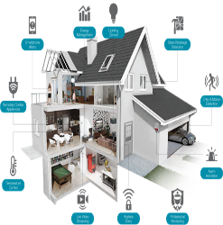
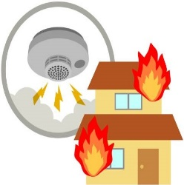
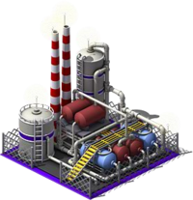
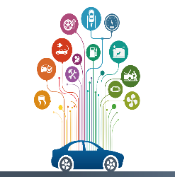

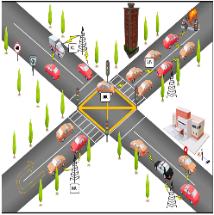

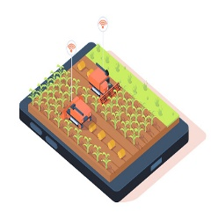








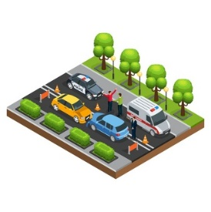
SYSTEM ARCHITECTURE
Smart Home
Smart Fire
Smart Gas
Smart Veh
Smart HC
Smart Road
Health
Smart Farm
Smart Pro
Gateway
Gateway
Gateway
Fog
Data Buffering
Fog
Clustering
Fog
Feature Extraction
LSTM Classifier
Deep Q Prioritization
Data Centre

Slide 16
SYSTEM REQUIREMENT
HARDWARE REQUIREMENTS
Processors: Intel® Core™ i5 processor 4300M at 2.60 GHz or 2.59 GHz (1 socket, 2 cores, 2 threads per core), 8 GB of DRAM
Disk space: 320 GB
Operating systems: Windows® 10, macOS*, and Linux*
SOFTWARE REQUIREMENTS
Server Side : Python 3.7.4(64-bit) or (32-bit) and PHP
Client Side : HTML, CSS, Bootstrap
IDE : Tkinter, Dreamviewer
Back end : MySQL 5.
Server : WampServer 2i

Slide 17
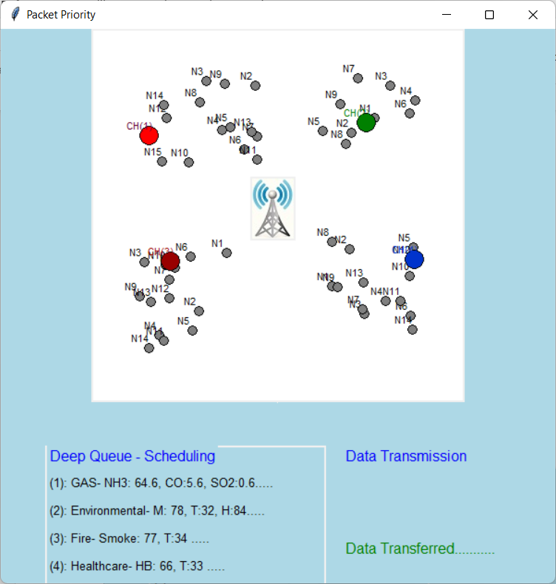
OUTPUT SCREENSHOT

Slide 18
CONCLUSION
In conclusion, the IoT Network Emergency packet classification using LSTM and Packet Scheduling using Deep Q Learning system has the potential to revolutionize emergency response systems in IoT networks. By accurately identifying emergency packets and prioritizing them, the system can help ensure that emergency responders receive critical information in a timely manner, potentially saving lives and minimizing damage. Overall, the IoT Network Emergency packet classification using LSTM and Packet Scheduling using Deep Q Learning system has the potential to significantly improve emergency response times in IoT networks, providing a fast and efficient response to critical situations.

Slide 19
FUTURE SCOPE
Multi-objective optimization: The system could be enhanced to optimize not only for emergency packet classification and packet scheduling.
Dynamic adaptation to changing network conditions: The system could be enhanced to dynamically adapt to changing network conditions.
Integration with other IoT devices and networks: The system could be enhanced to integrate with other IoT devices and networks, such as wearable devices and smart home systems.
User interface improvements: The system could be enhanced by improving the user interface, making it more intuitive and user-friendly for emergency responders and network administrators.

Slide 20


